Slide 1
NFL: Beating the Spread
Russell Haws
Alejandro Llamas
Emmanuel Llamas

Slide 2
Motivation & Summary Slide
What is the Spread?
If the Texans are favored by 7, and win by 10, they covered the spread
Football season is around the corner! As fans, we are always looking for a way to inherently find patterns, or gain an advantage in an environment designed for parity
We sought to find any patterns within overall team statistics to find any correlations to teams covering the spread, not necessarily winning games
We were able to see some baseline statistics and found some interesting insights, but we failed to find an exact model based on our data to confirm whether offensive categories relate to beating Vegas

Slide 3
Question & Data
What are the relationships between offensive and defensive team statistics and their ability to beat the spread
For example, do the top offenses consistently beat the spread? Do bad defenses not allow teams to cover?
Data Requirements:
All 267 game results for the 2018 NFL season
All spreads, favorites and underdogs
All team statistics, subcategories of season-long performance (i.e. 4th quarter points surrendered)
Data Sources:
Pro-Football-Reference.com
ESPN.com
Oddsshark.com
We were unable to obtain API’s for ESPN, CBS, etc. All sources were copy pasted from tables into csv files, and referenced throughout jupyter notebook

Slide 4
Data Cleanup & Exploration
All our data sources were scoured from the internet, saved in csv format and we used Pandas to present the data in Jupyter Lab
We unexpectedly had a few problems with tables that we identified, that some were just team names, city names, or a combination of the two, which made merging sources challenging.
Also had a challenge with trailing spaces and inconsistent formatting between csv files
Once we had those initial challenges resolved, we were able to find some interesting insights very quickly:
Win Totals & Wins against the spread
How many favorites and underdogs beat the spread
Home and away teams who beat the spread

Slide 5
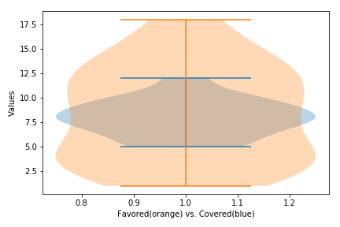
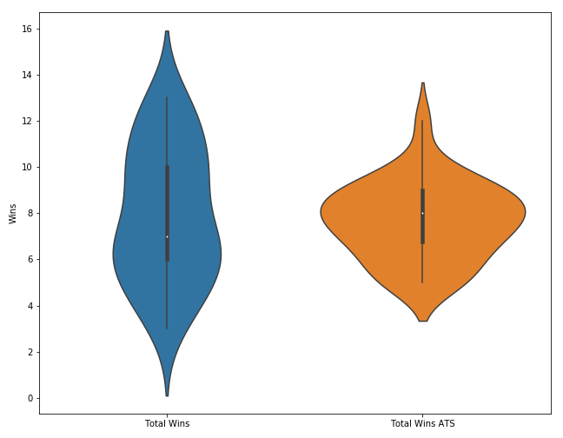
Data Analysis
There was a stark range of total wins for NFL teams in 2018; however, the vast majority of teams in 2018 were within a few games of .500 when going against the spread

Slide 6
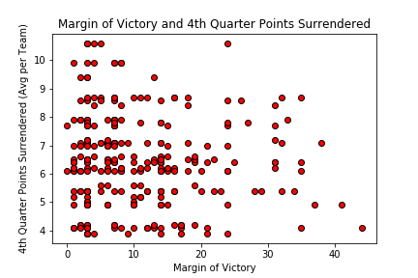
What are we finding?
Average Margin of Victory in the NFL was 10.96 points
The Average spread was -5.335
If for no other strategy, you would have been a loser gambling only on the favorites for the 2018 season: they were a combined 122 – 134 – 11
Average Margin of Victory for the Favorite: 16.04 points
Average Margin of Victory for the Underdog: 6.89 points
We wanted to find a better strategy than betting the favorites

Slide 7
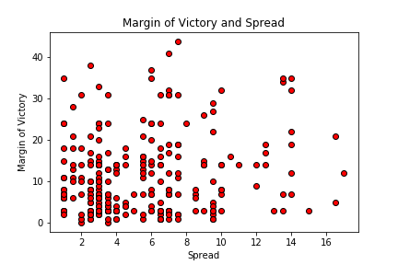
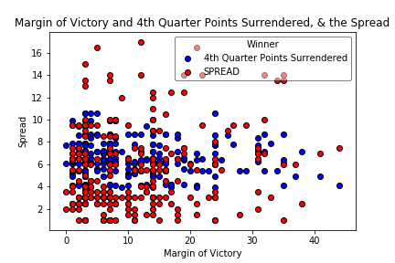
Additional Scenarios
A few other team-based trends we tried to identify:

Slide 8
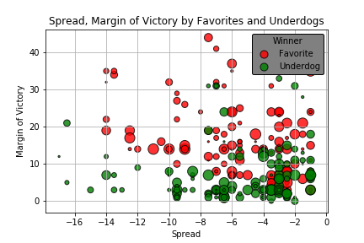
Offensive Firepower
The vast majority of the wins by the underdog were under 5 point spreads
19 underdogs won when the spread was -3, 11 when the spread was -2.5
Favorites were often less likely to cover the larger spreads, as shown by the multiple favorites winning, but by a fraction of the spread
Size of the circle is based on season long offensive ranking; the larger the circle, the worse the offensive ranking

Slide 9
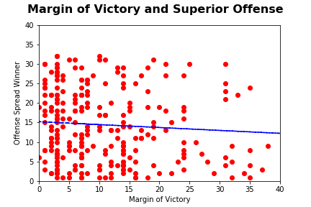
Regression Test
Unfortunately, we were unable to find a statistically significant relationship between the offensive rank of the winning team and the margin of victory, the R Squared value was 0.343.
Based on the data, there was no way to say that a superior offense would lead to covering the spread.

Slide 10
What Did We Discover?
Expected a stronger correlation between offensive performance and covering the spread
When we did not find a correlation between offenses and covering, was more shocked to see 4th quarter points surrender not have as much an impact as conventional wisdom would dictate
The higher the spread, the less likely the favorite is to cover
The best opportunity for the underdog to cover is the spread at -2.5 or -3, which easily translates to a field goal

Slide 11
Post Mortem
Difficulties in data sources, cleaning, all team members referencing same csv files
Ended up cutting the branches and used one master GitHub location
In terms of identifying statistical significance in our findings, we would need to find more granular data before performing any additional regression, including:
Week over Week trends
Injuries/Suspensions
Weather/Dome stadium
Individual Match-ups
Would like to identify a ratio to say as the spread increases, the probability of covering decreases

Slide 12
Questions?

